Slide 1

VISTAcare
THE COVID
MANAGEMET SYSTEM

Slide 2
COMPUTER PROJECT 2021 BY AKHILESH NEVATIA AND YUVRAJ SINGH
INDEX:
1)CERTIFICATE 2)PROJECT DESCRIPTION
3)BLOCK DIAGRAM 4)PACKAGE AND MODULE
5)CODE 6)INPUT AND OUTPUTS
7)BIBLOGRAPHY 8)THANK YOU

Slide 3
2) PROJECT DESCRIPTION
OBJECTIVE:
This diagnostic management tool is designed to help small clinics or hospitals in these tough times of the covid pandemic by creating tables and storing staff and patient information leading to an efficient flow while working in the hospital. It comes has an added feature of a basic QandA test which acts as a preliminary test in order to separate out most likely covid cases at times of high traffic in hospitals.

Slide 4
2) PROJECT DESCRIPTION
PROBLEM IDENTIFICATION:
“THE COVID PANDEMIC” – The most unexpected Virus the world has ever seen. It has effected the life of every individual across the world and while everyone is in turmoil , they depend on DOCTORS and HOSPITALS to help save their lives or to cure them.
It is of utmost importance in these unprecedented times to ensure that hospitals run efficiently keeping a record of all the hospital staff and patients to maintain regularity and uniformity in their functioning . Through the covid management system we present to you today , we will show you how the hospital can do so by using tables made by us to store information as an Admin.
It is also seen that even though everyone is aware of the virus called COVID-19 , most of the people aren’t familiar with the symptoms. To help solve this Problem we have come up with a series of Questions based on symptoms which the patient should answer before a Covid Test , giving him a likely prediction whether he should go ahead with a swab test in the hospital or not. This helps patient gain some information about the symptoms and at the same time decide if he needs to go for a covid test immediately.

Slide 5
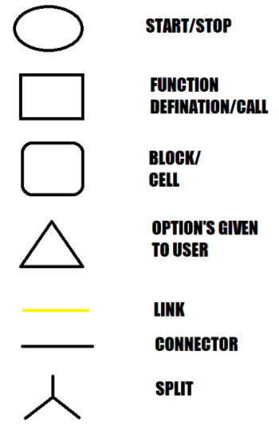
3) BLOCK DIAGRAM
KEY:

Slide 6
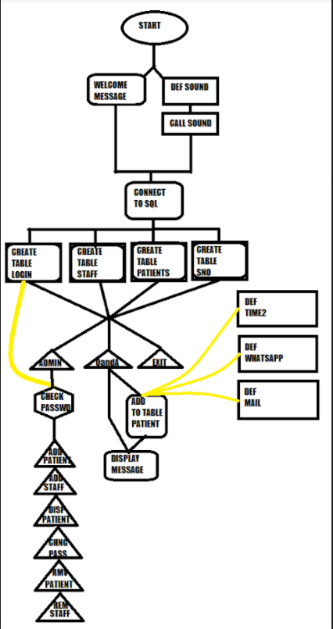
3) BLOCK DIAGRAM

Slide 7
4) PACKAGE AND MODULES
BUILTIN MODULES:
1) MYSQL.CONNECTOR
2)TIME
EXTERNAL MODULES:
1)PYWHATKIT
2)SMTPLIB
3)PLAYSOUND
EXTERNAL AUDIO FILE:
1)NG.MP3

Slide 8

CODE

Slide 9
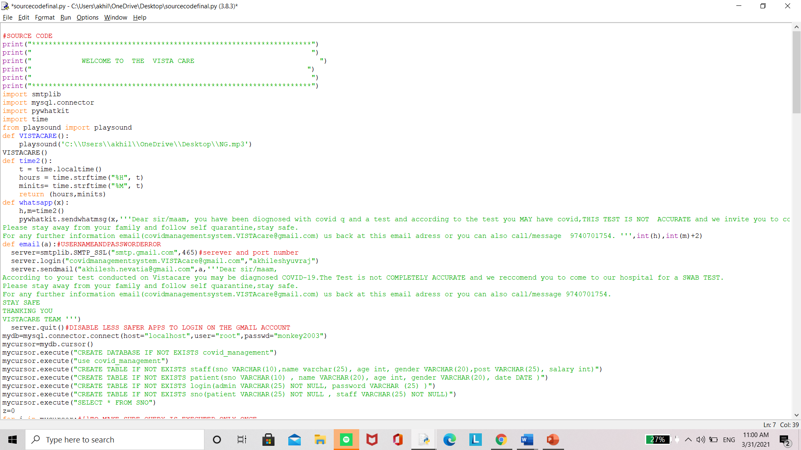
CODE FROM IDLE:

Slide 10
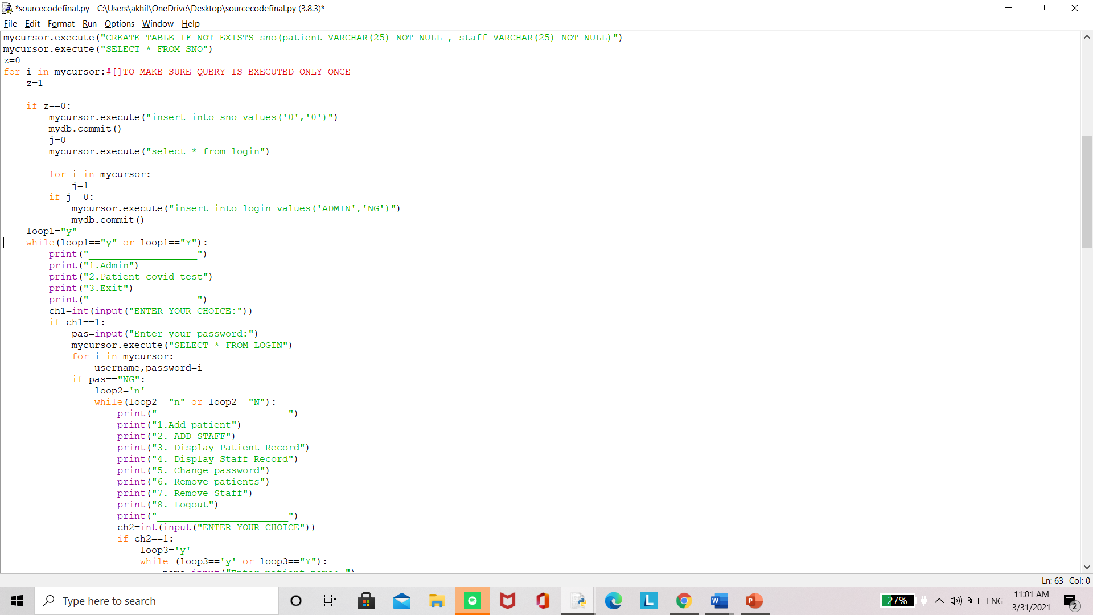

Slide 11
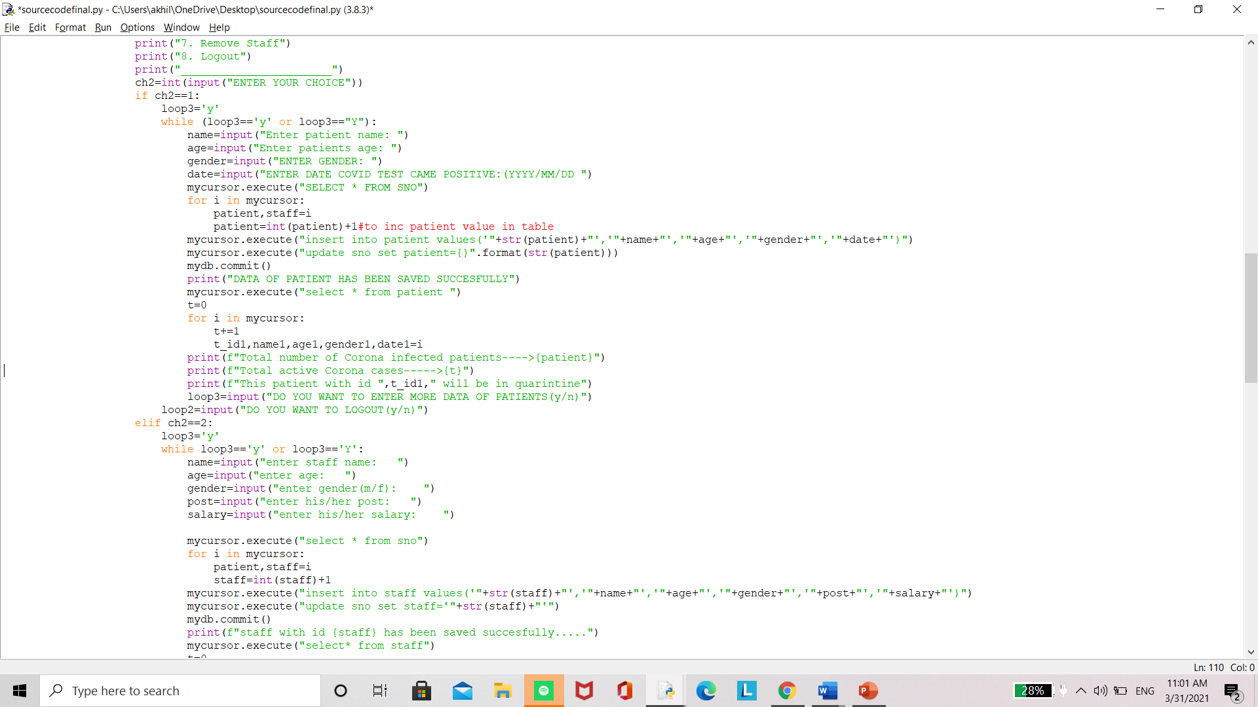

Slide 12
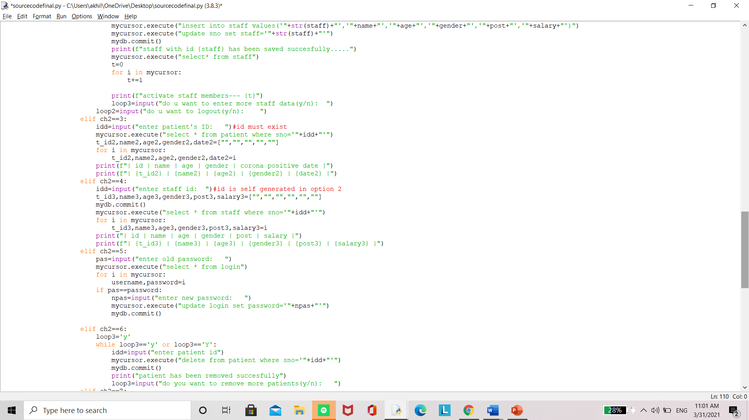

Slide 13
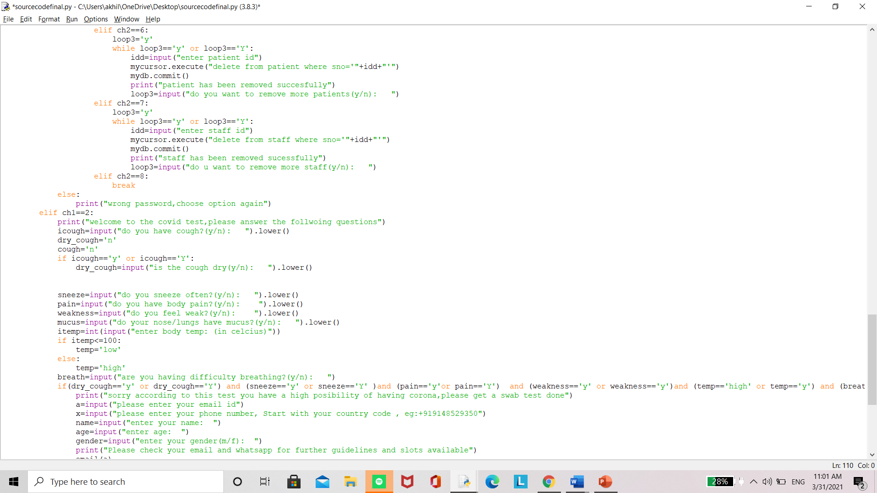

Slide 14
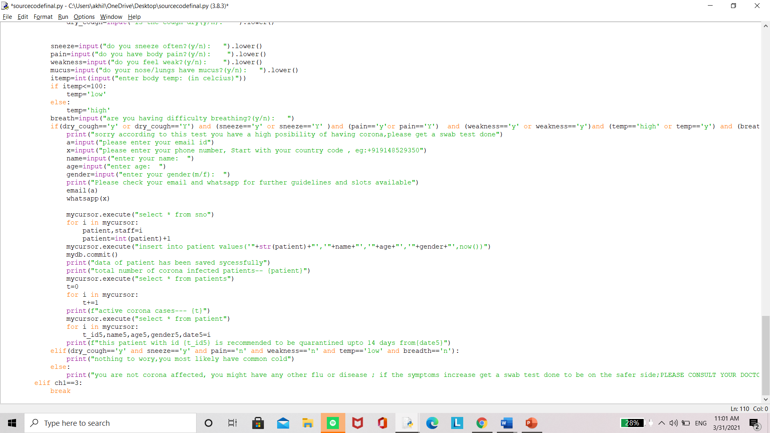

Slide 15
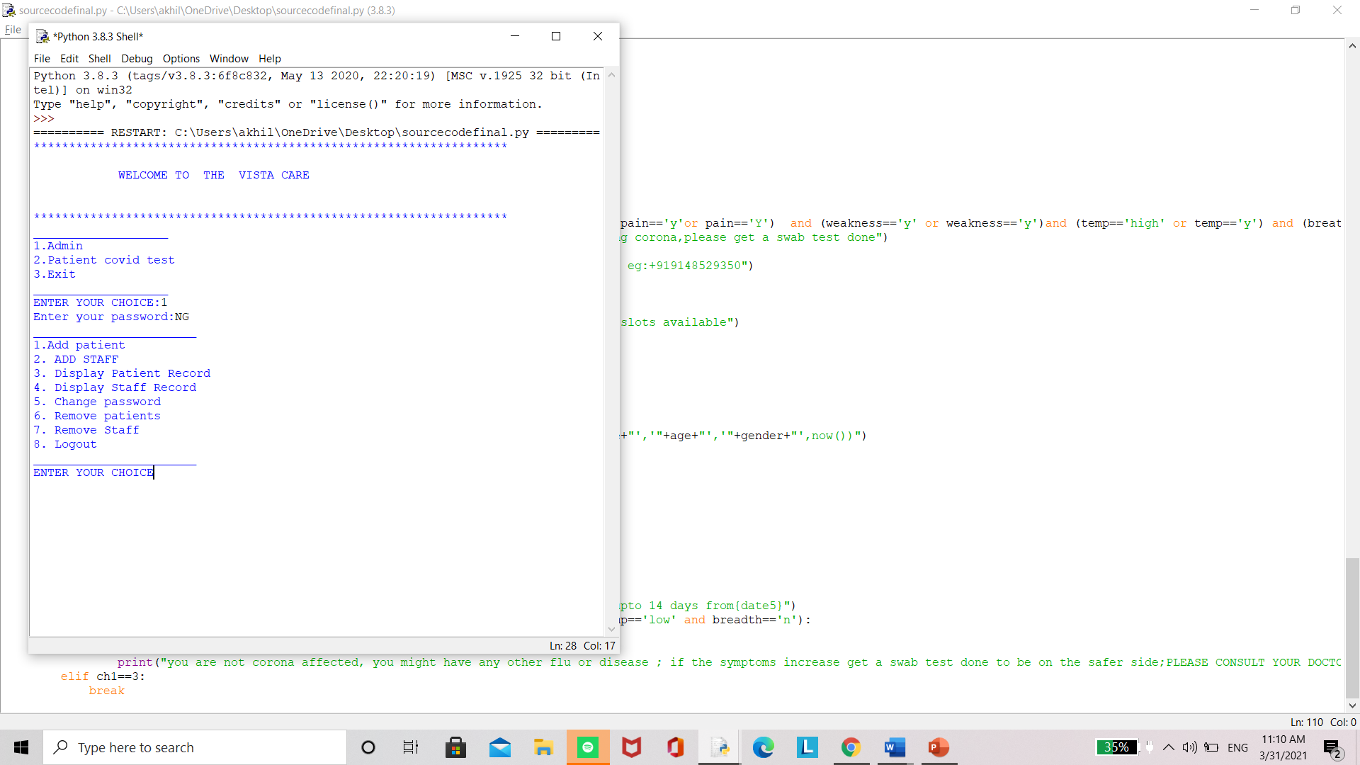
INPUTS AND OUTPUTS

Slide 16
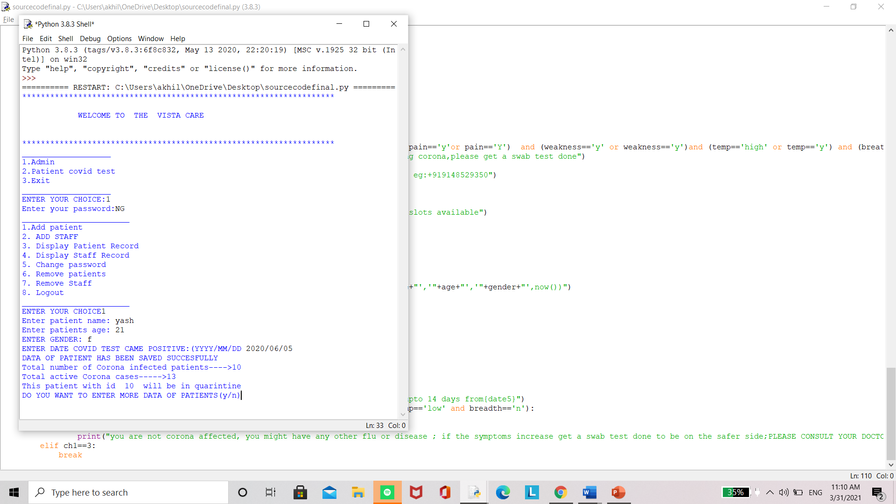

Slide 17
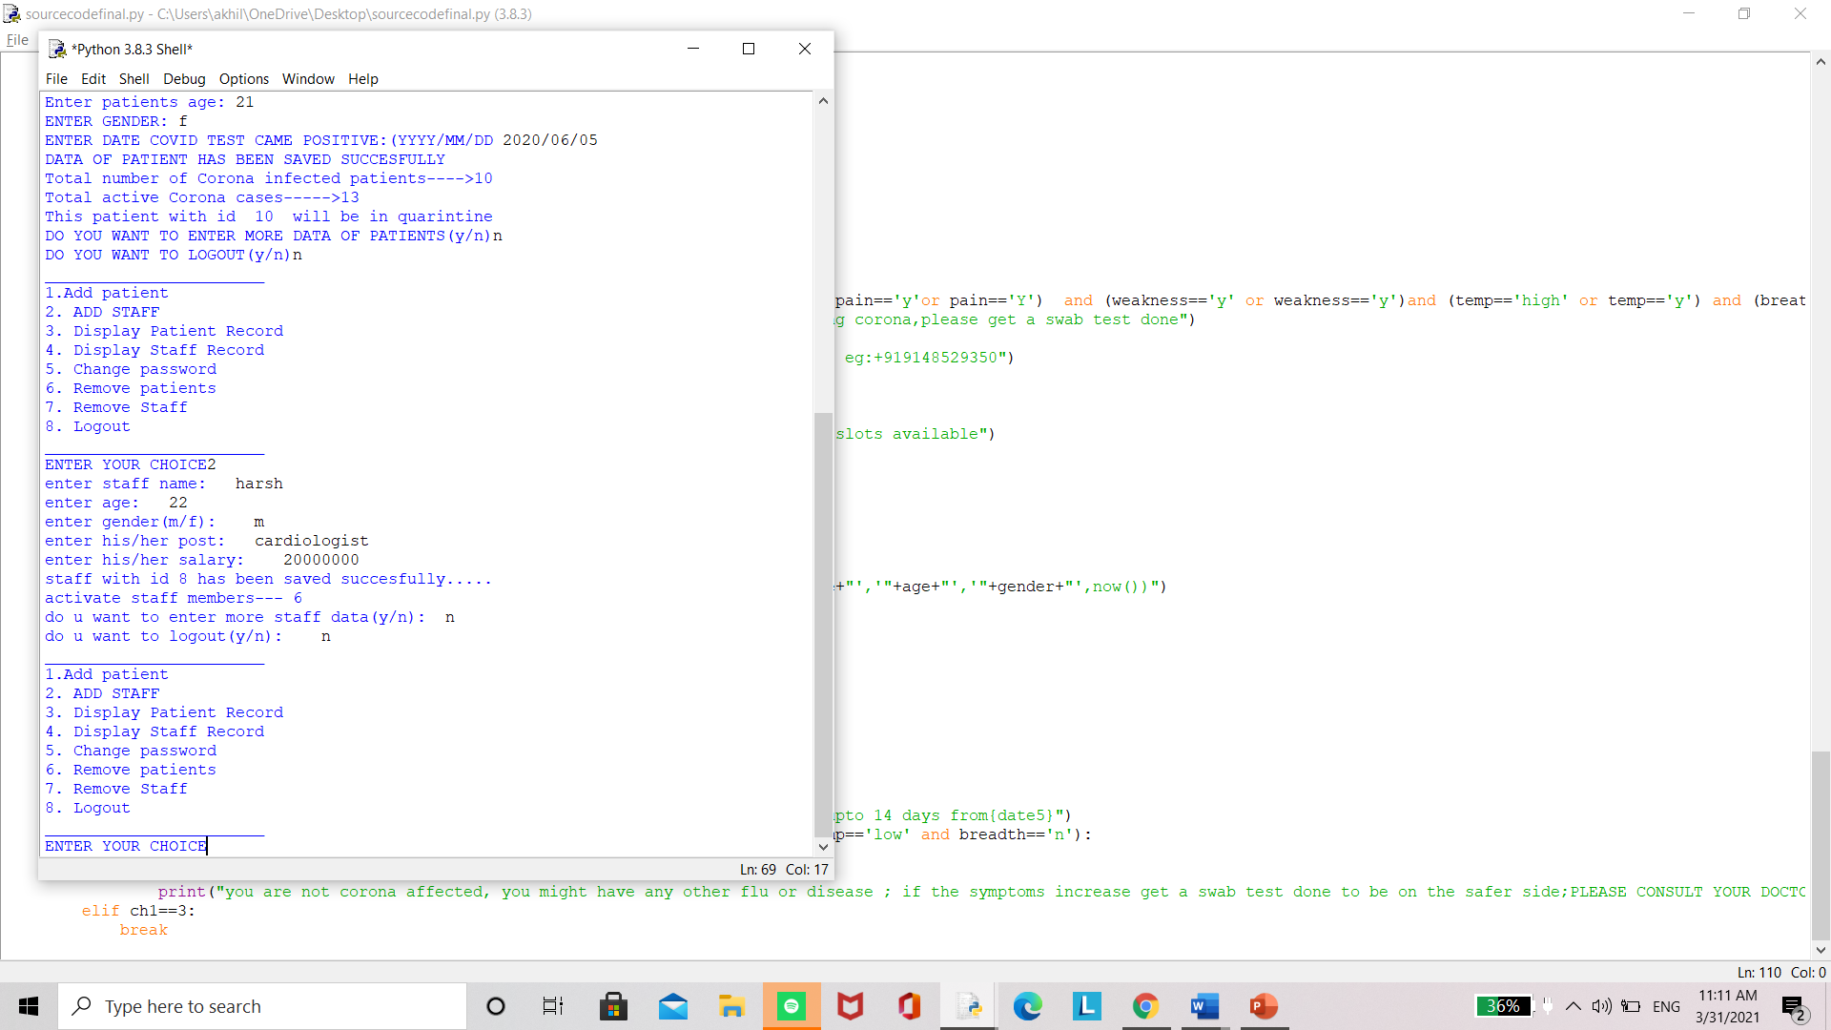

Slide 18
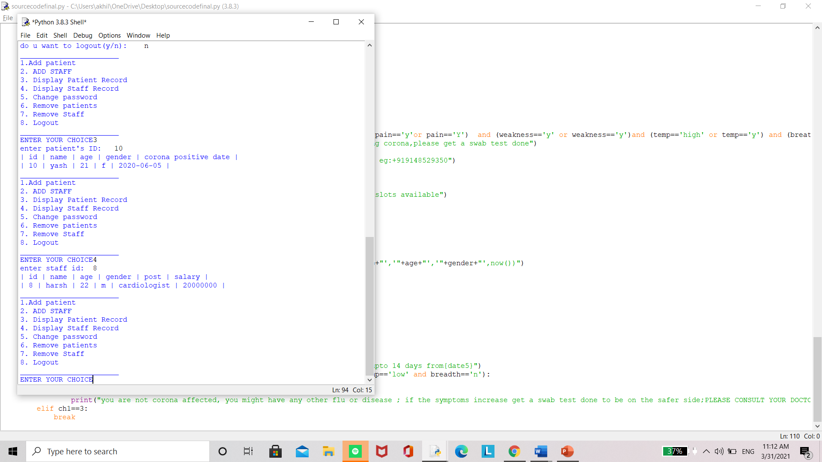

Slide 19
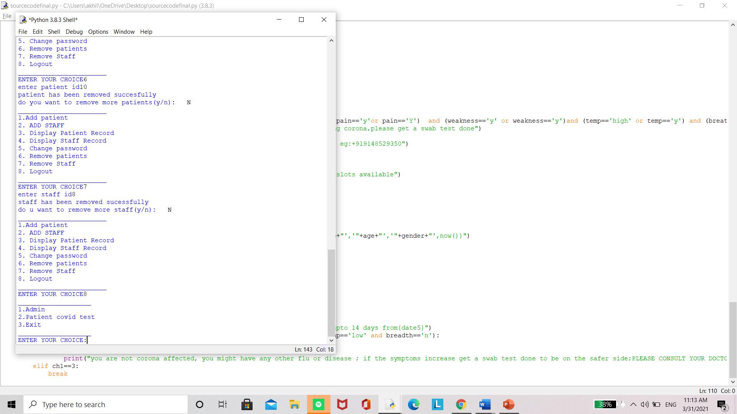

Slide 20
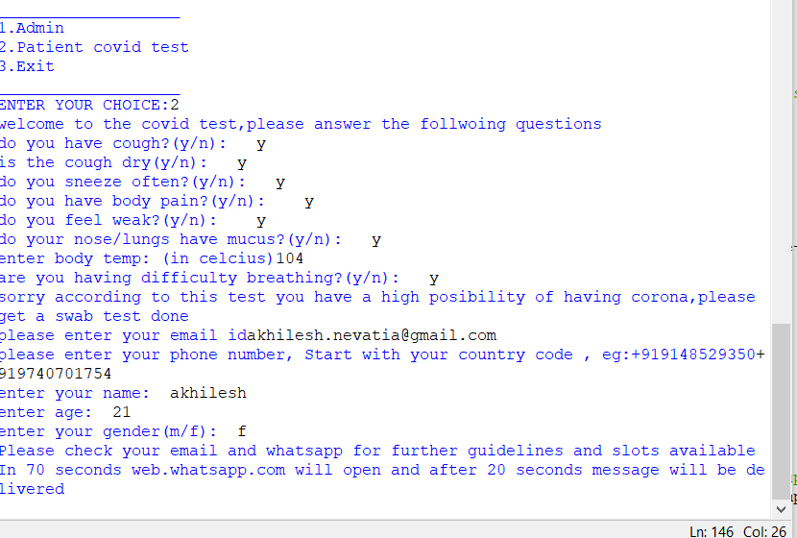
Covid QandA test OUTPUT

Slide 21
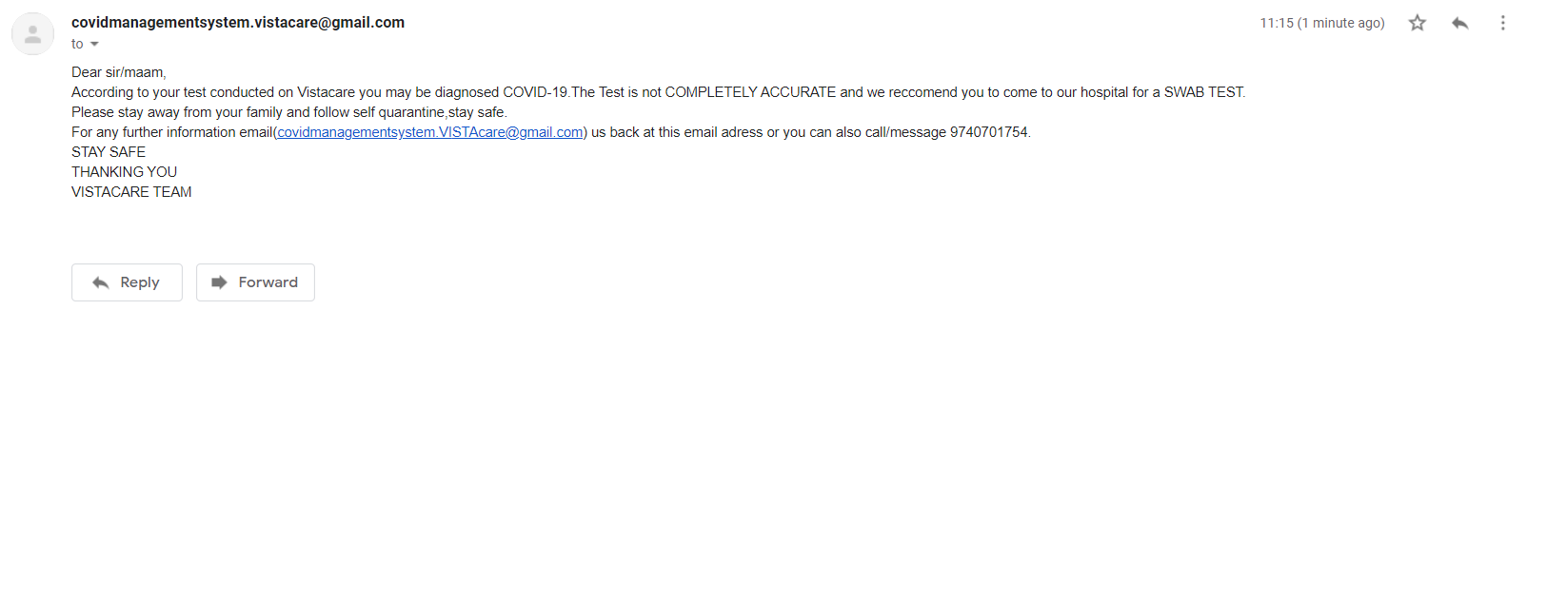
Automated email sent to patient

Slide 22
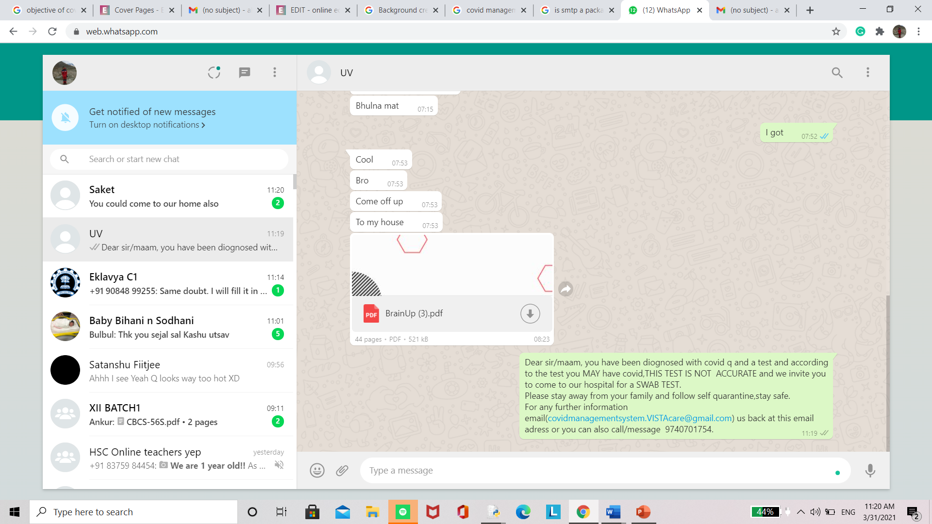
Whatsapp sent from admins phone number

Slide 23
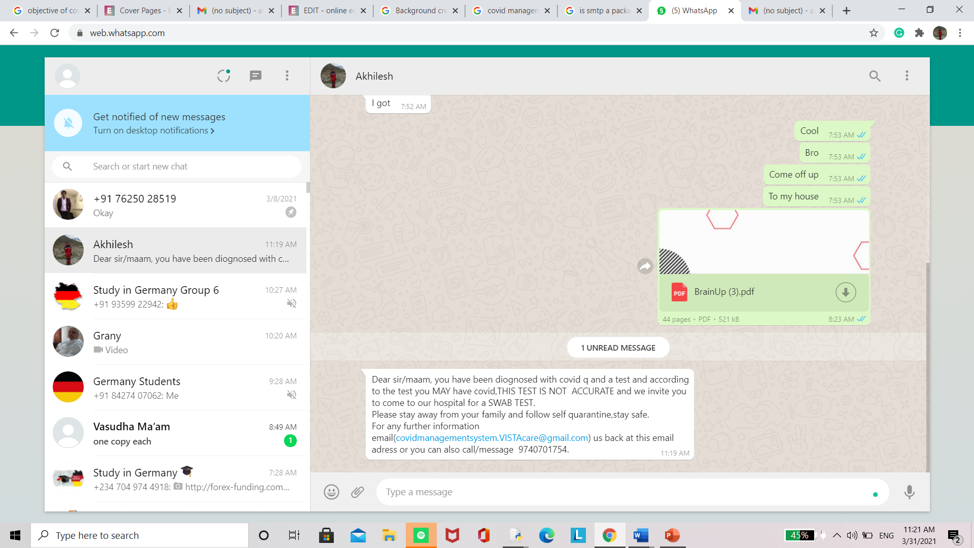
Whatsapp (clients side)

Slide 24
biblography
1) https://realpython.com/
2) https://www.geeksforgeeks.org/convert-text-speech-python/
3) https://www.freecodecamp.org/news/send-emails-using-code-4fcea9df63f/
4) https://www.twilio.com/blog/send-whatsapp-message-30-seconds-python
5)github

Slide 25

THANK YOU Vasudha maam for being such a wonderful teacher. We also would like to thank cbse for giving us this opportunity to present our talent through this project

